Slide 1
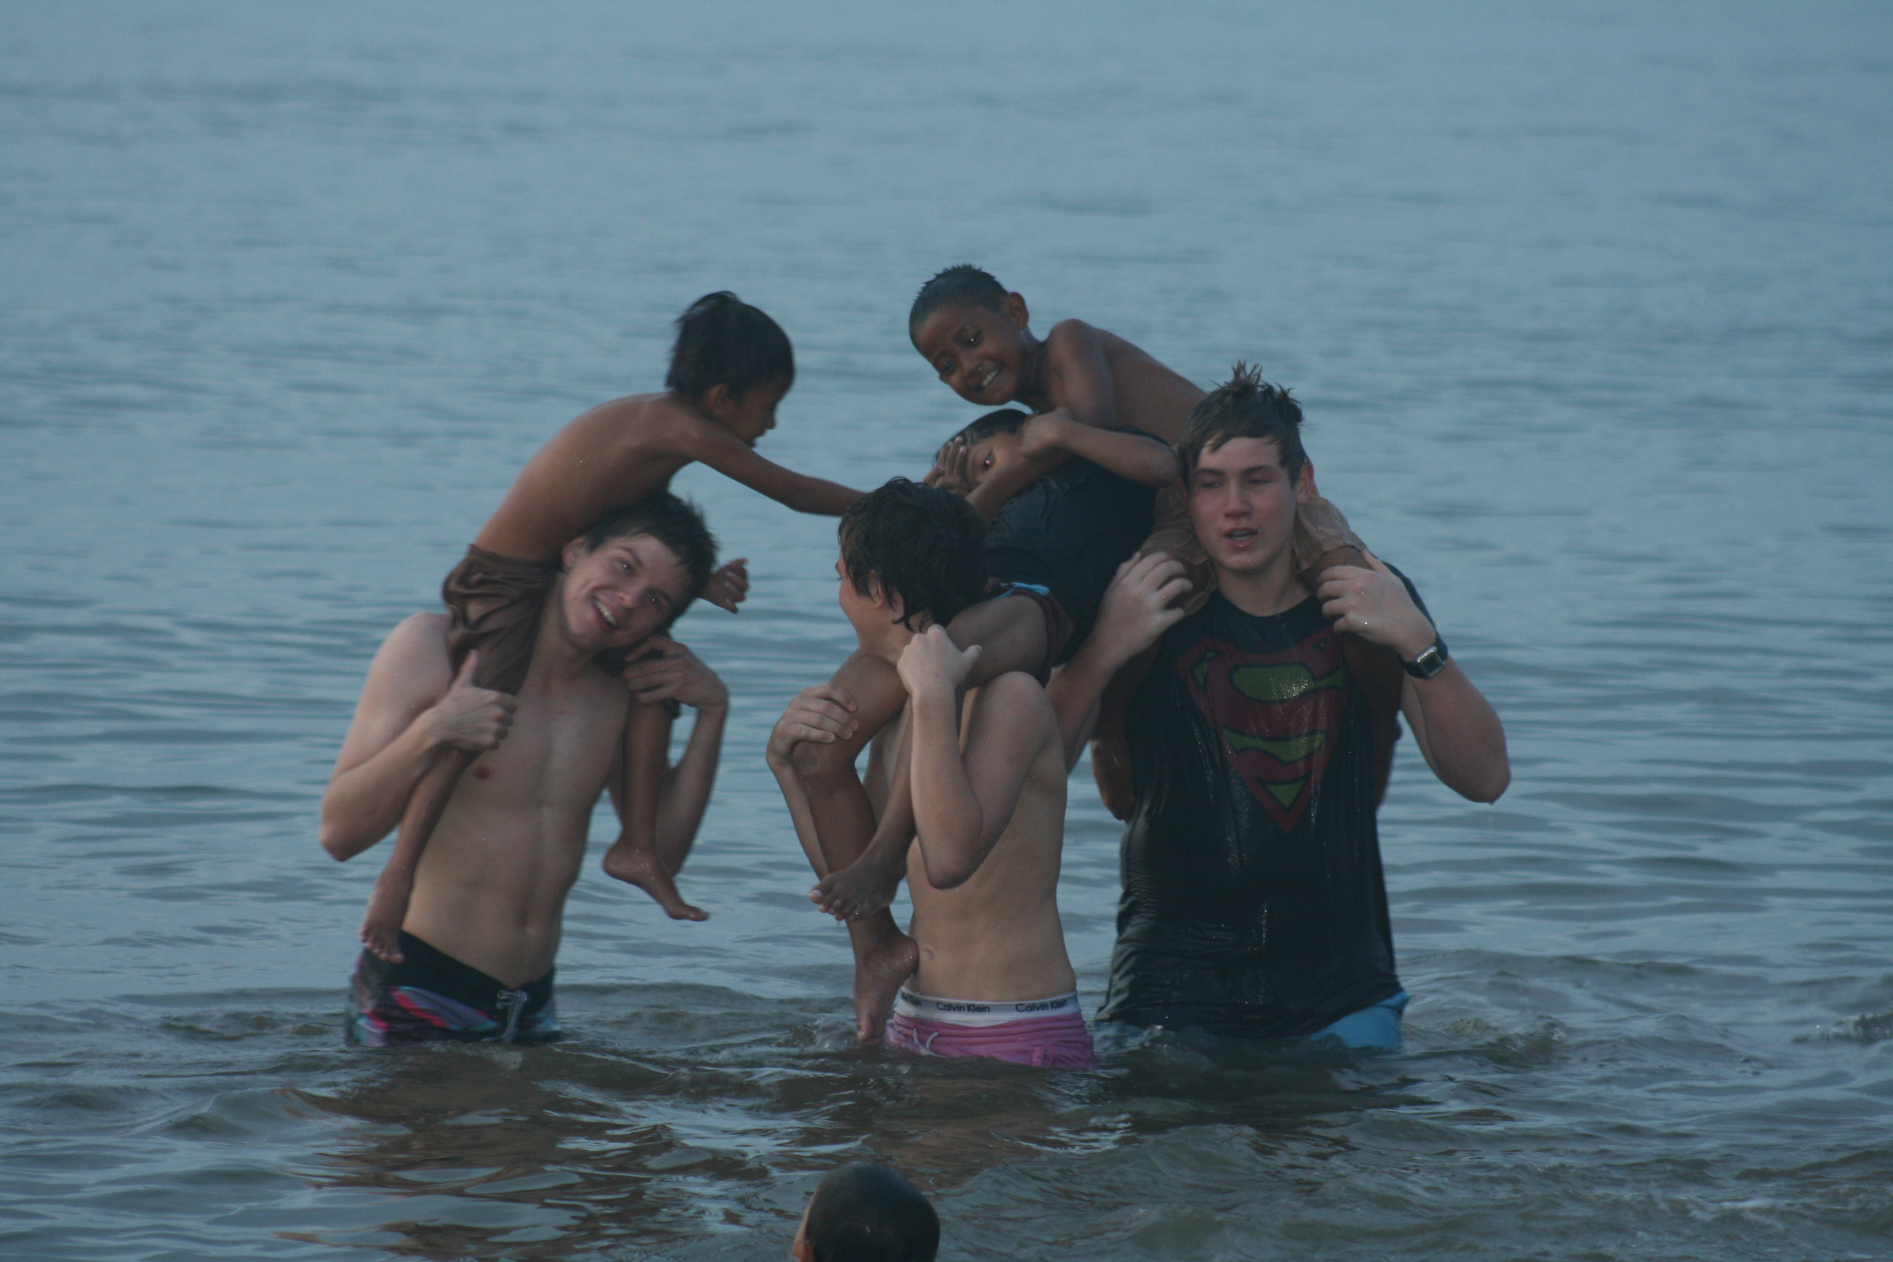
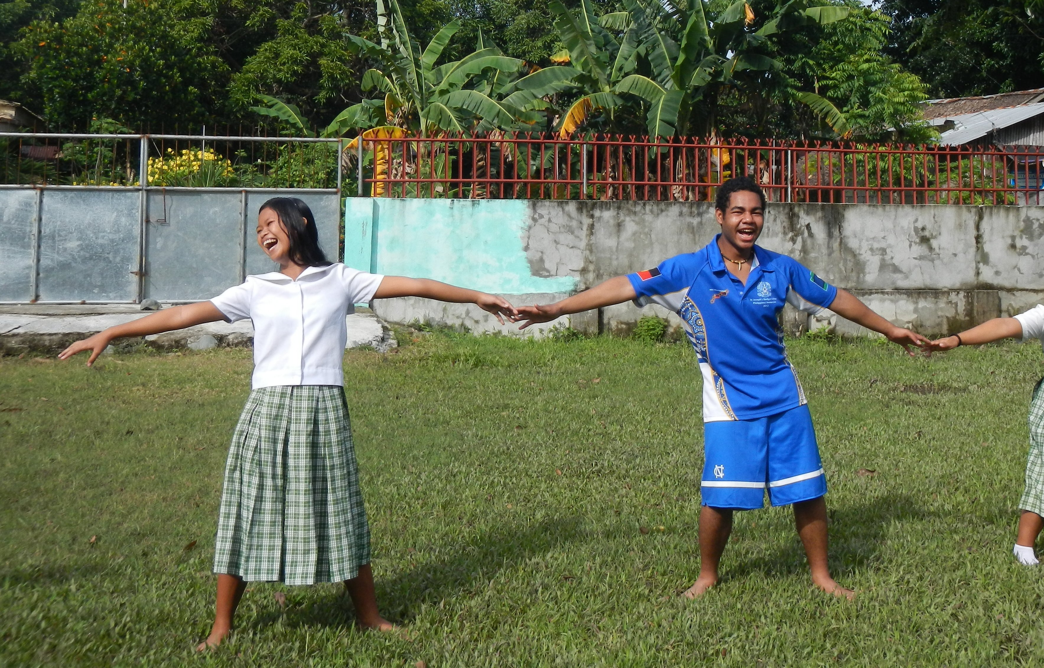
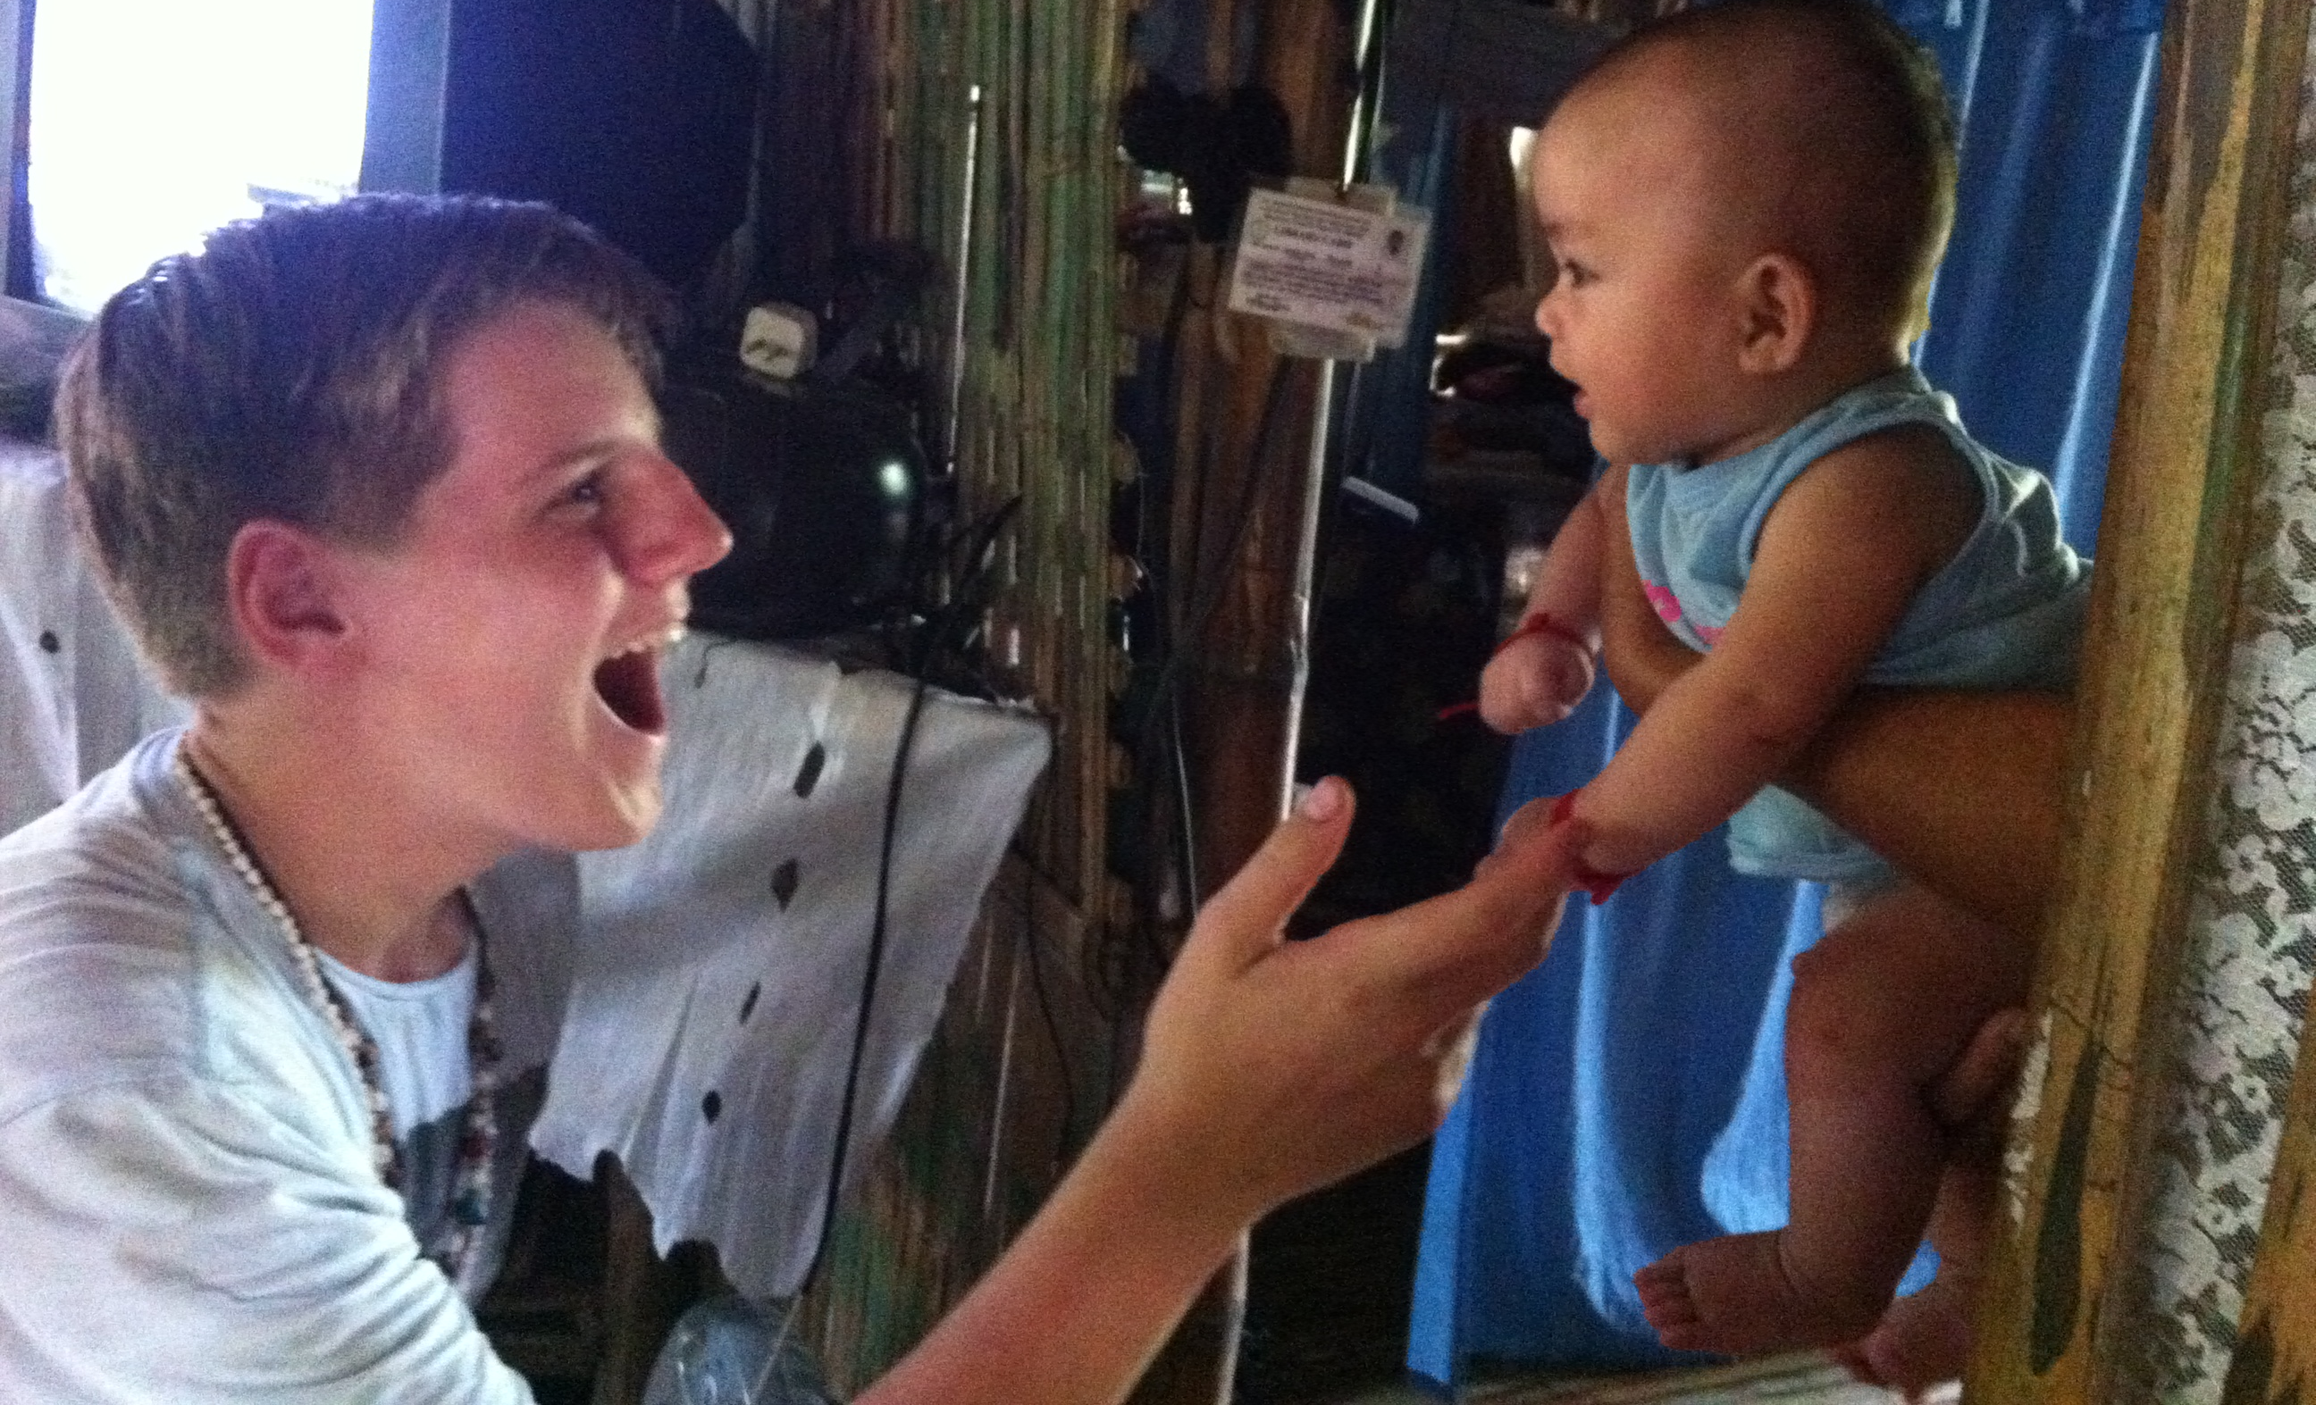
Gap Year Options
Volunteering in 2014??

Slide 2
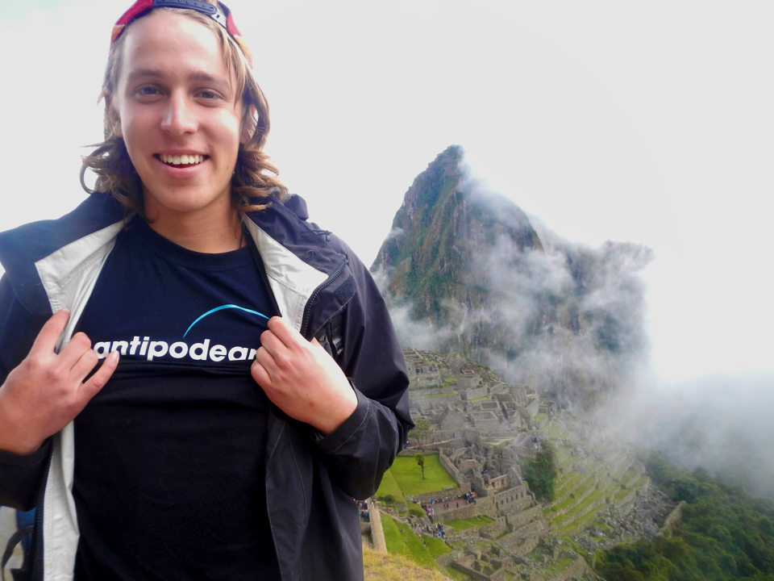
Travel, explore, give back, grow, and unwind on your GapBreak with Antipodeans Abroad in 2014
Volunteer & work placements for high school leavers aged 17-19
Destinations throughout Africa, Asia, & North & South America
1, 3, & 6 month placements
Program costs start at $1750 depending on destination
ANTIPODEANS ABROAD: GAPBREAK

Slide 3
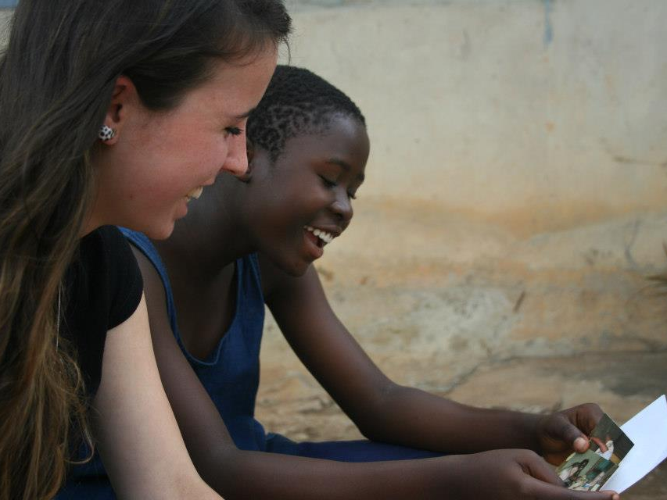
FIND OUT MORE!
Website: www.antipodeans.com.au
Call:
(02) 9413 1522
Email: explore@antipodeans.com.au
Information Nights:
Brisbane, dates TBC
Kenya Brazil Tanzania Argentina USA Canada UK Peru Ghana Ecuador Nepal China India Cambodia Borneo Southern Africa Combo South Africa France Mauritius

Slide 4
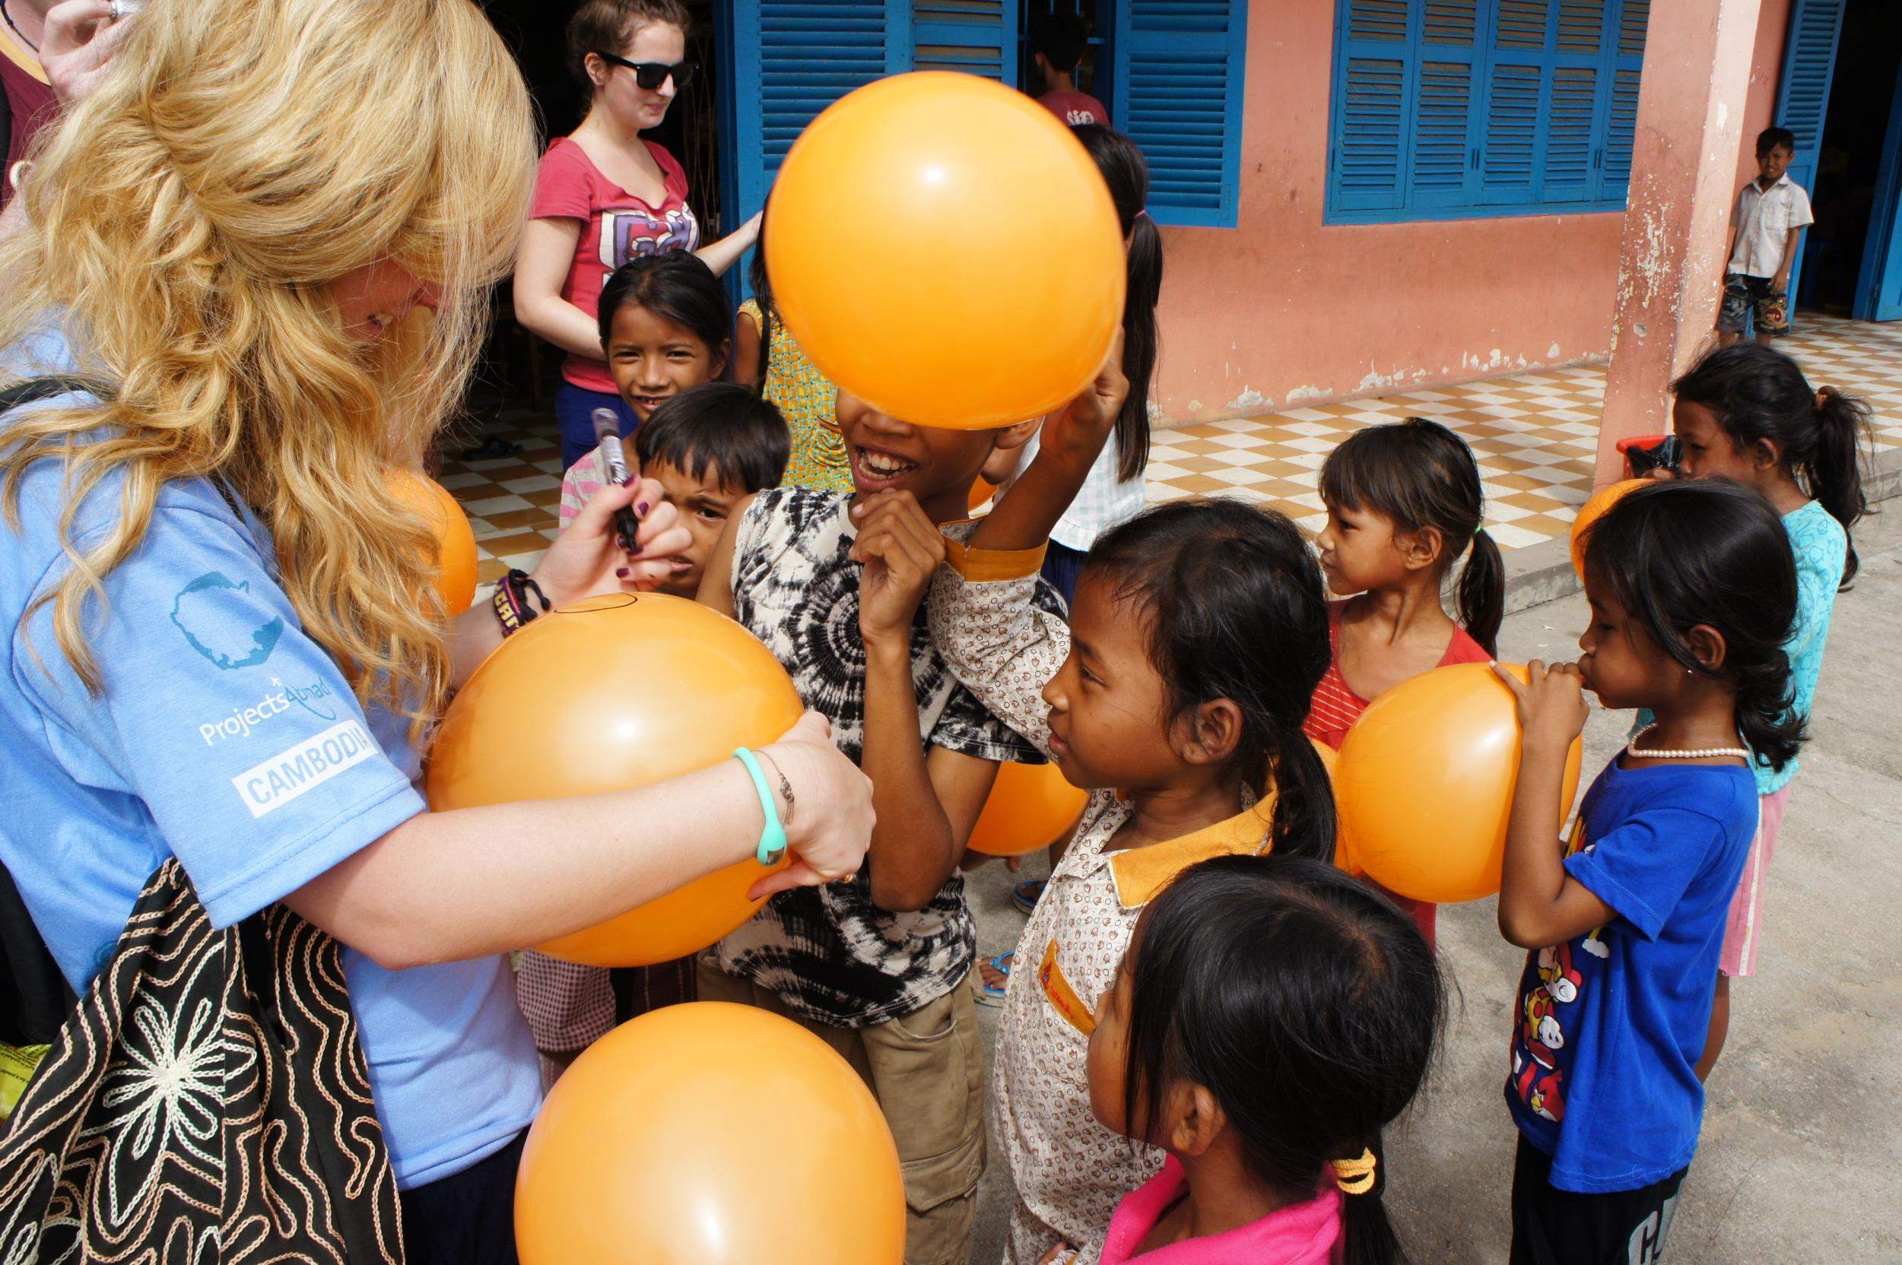

PROJECTS ABROAD
SAFE, SUPPORTED & SUSTAINABLE PROJECTS IN 29 COUNTRIES
About Projects Abroad
Practical, educational, sustainable and adventurous programmes
29 countries, over 1000 individual projects
500 global staff – unique local support and direction
Stay with a host family
Flexible start dates and project duration
Volunteer community – volunteers from all around the world
One month project between $2045 - $3595

Slide 5
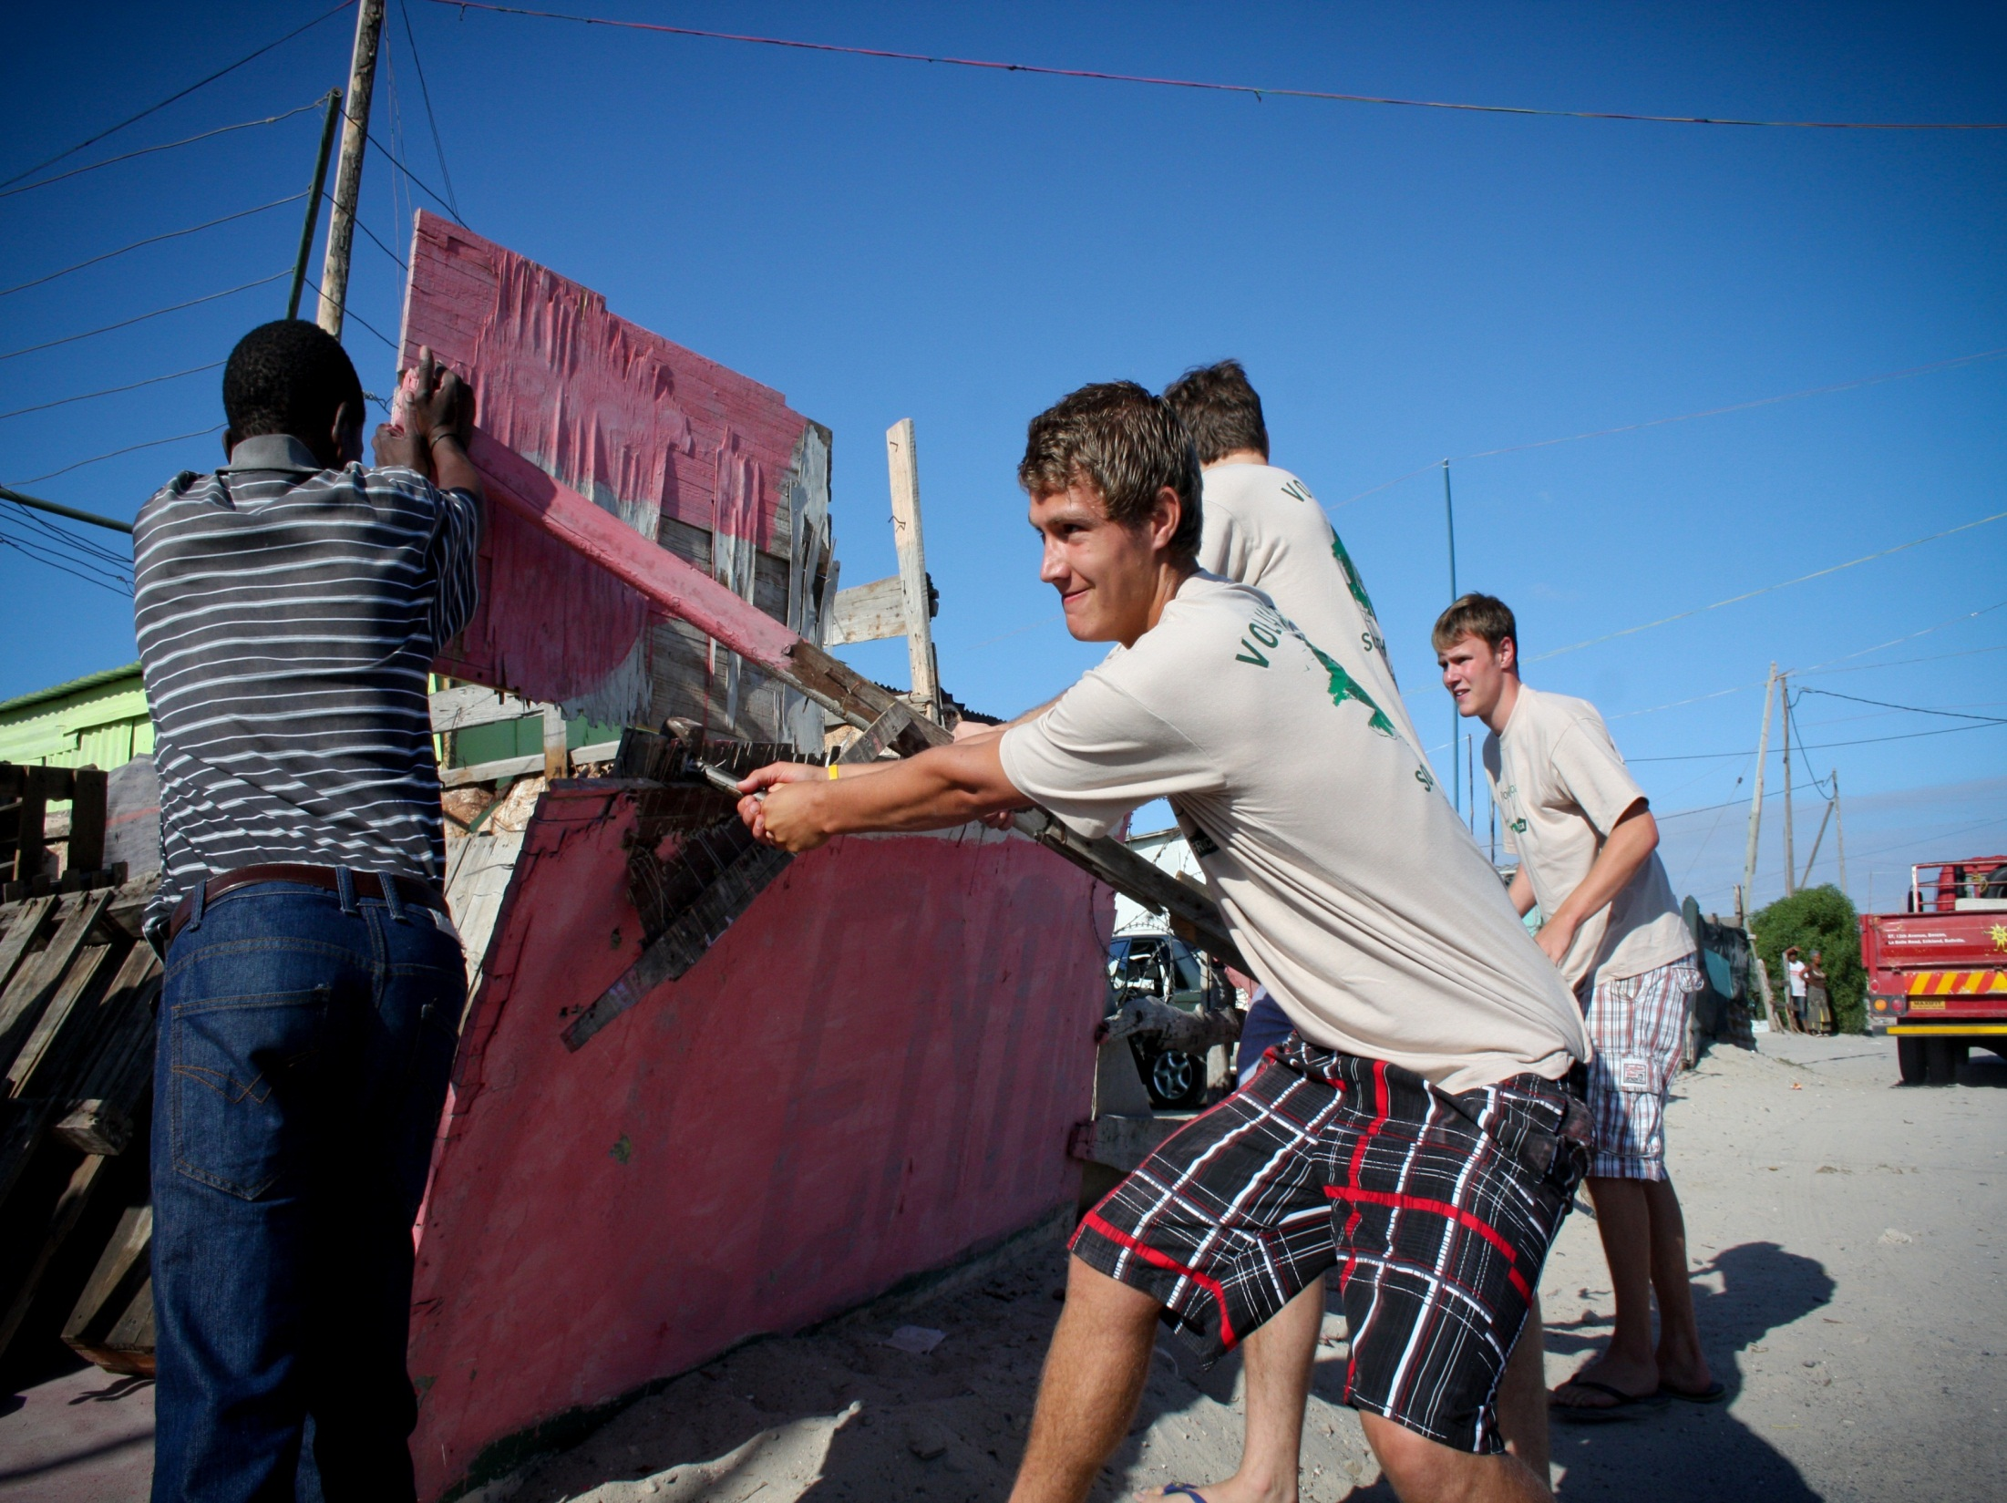
Minimum age 16
Summer break or gap year
Programmes for year 10 and 11
Volunteer & Work Experience
COMMUNITY WORK
Conservation
Care
Teaching & Sports
Building
WORK EXPERIENCE/VOLUNTEER
Medical & Healthcare
Humans Rights & Law
Business
Journalism
UNIQUE PROJECTS
For example care for disadvantaged children in Samoa, human rights work in Cape Town or rainforest conservation in the Peruvian Amazon
CONTACT US
1300 132 831
www.projects-abroad.com.au

Slide 6
WORLD YOUTH INTERNATIONAL
Established in 1988
Head Office based in Adelaide, SA
Signatory to the Australian Council for International Development (ACFID)

Slide 7
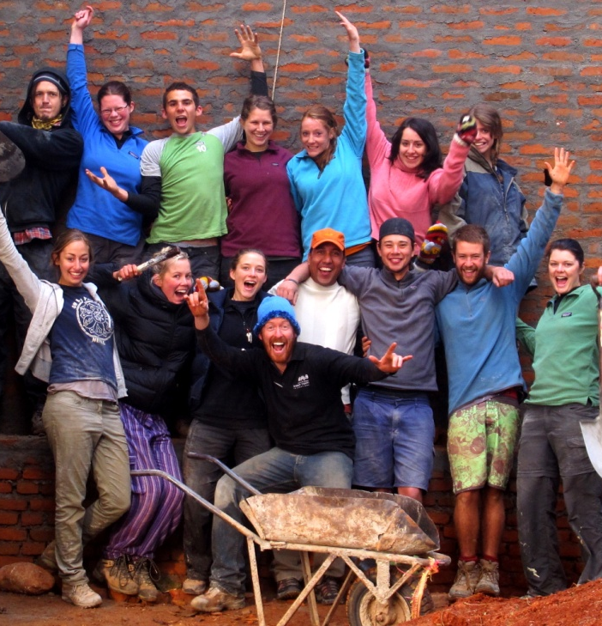
Overseas Action Program
Team program
Led by a professionally-trained Team Leader
For people aged 18 to 30
Five or ten weeks in length
Specific skills and qualifications not required

Slide 8
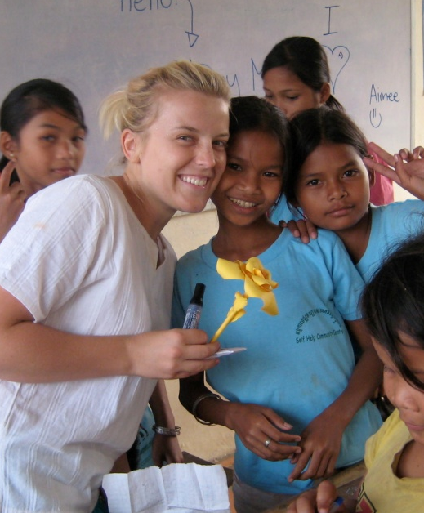
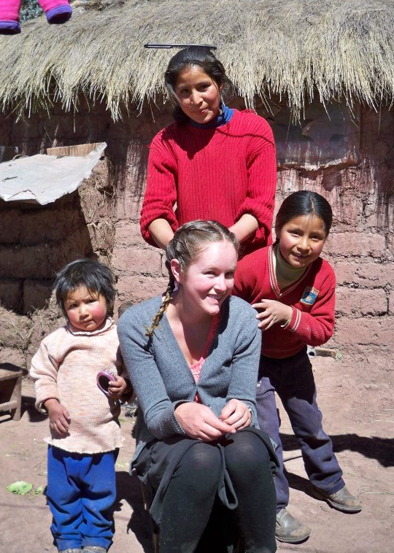
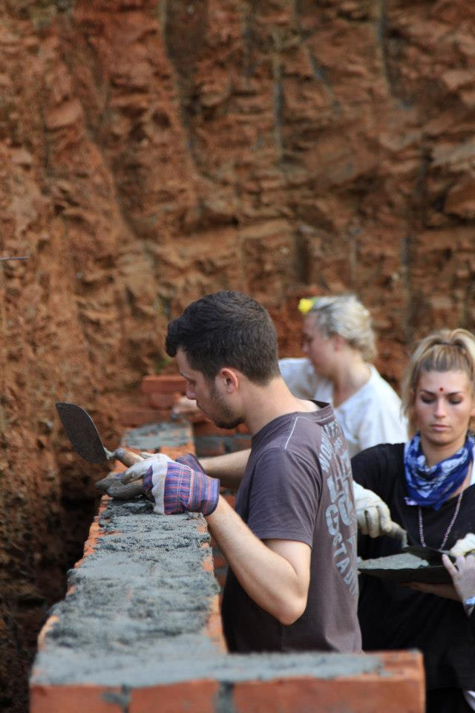
Overseas Action Program
Get your hands dirty working on construction projects
Live alongside local communities in:
KENYA
NEPAL
PERU
CAMBODIA

Slide 9
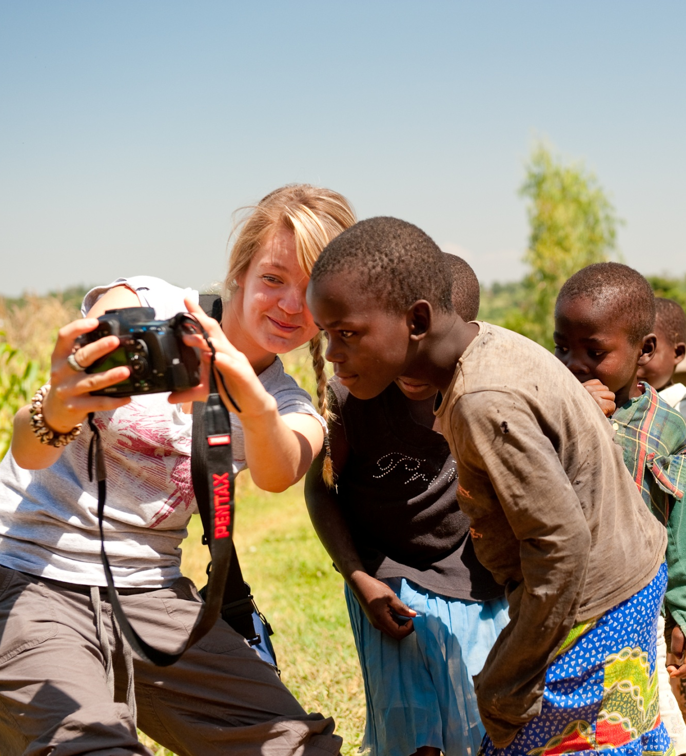
For More
Information:
Visit worldyouth.org.au
Call (08) 8340 1266 and speak with our friendly staff
Email us at admin@worldyouth.org.au
Like our Facebook page
Follow us on Twitter @WYIAustralia

Slide 10







Leading provider of overseas short term volunteer placements – 2 weeks to 3 months
www.i-to-i.com
Gap Year specialists:
Internships
Adventure Tours
Working Holidays
www.realgap.com.au
200+ projects, trips and programmes in 35 countries

Slide 11
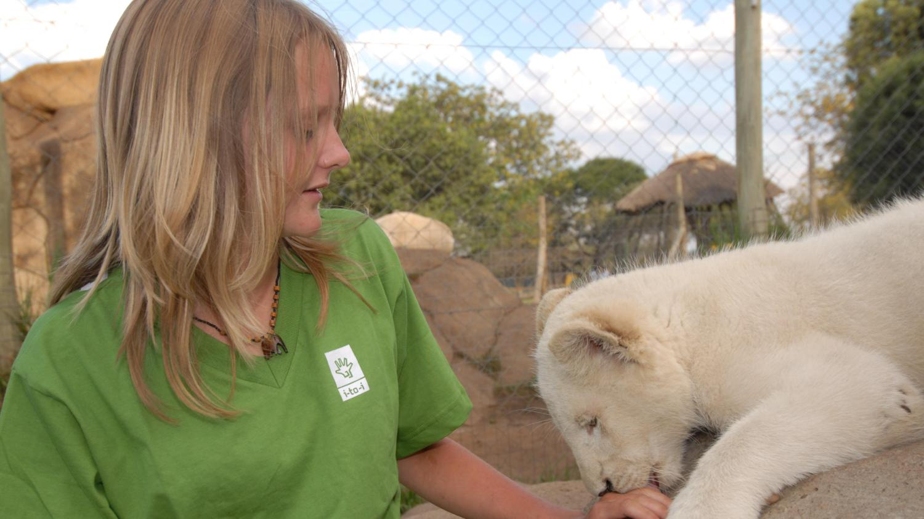

Live with Lion Cubs, South Africa
2, 3 or 4 weeks – the ultimate hands-on wildlife experience
www.i-to-i.com

Slide 12

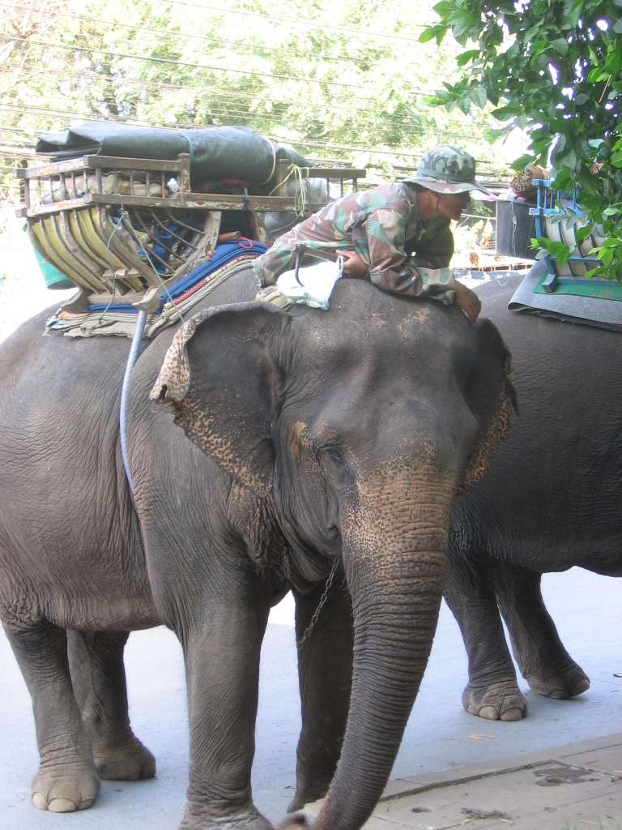
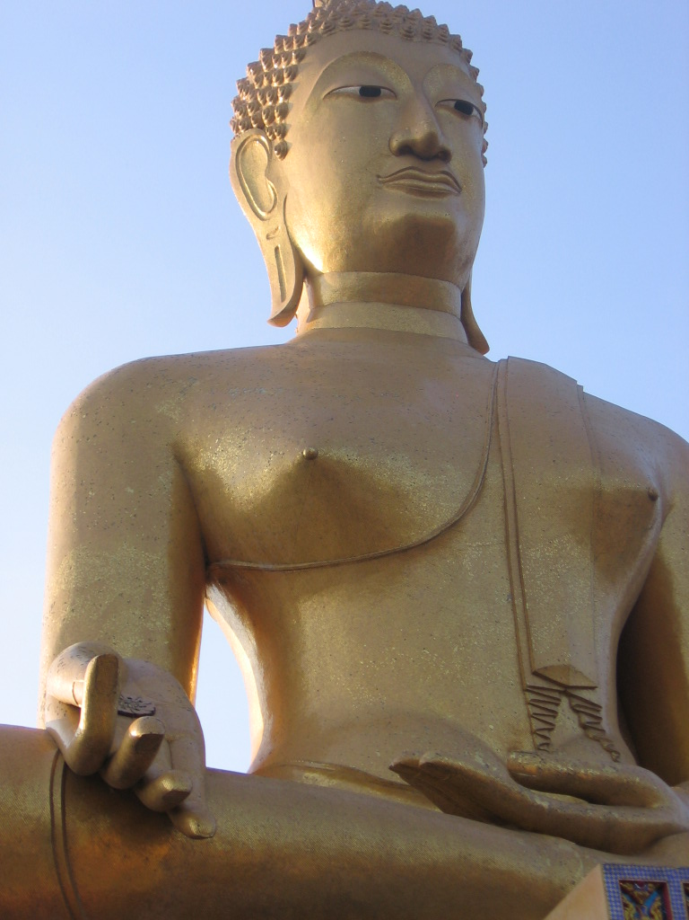
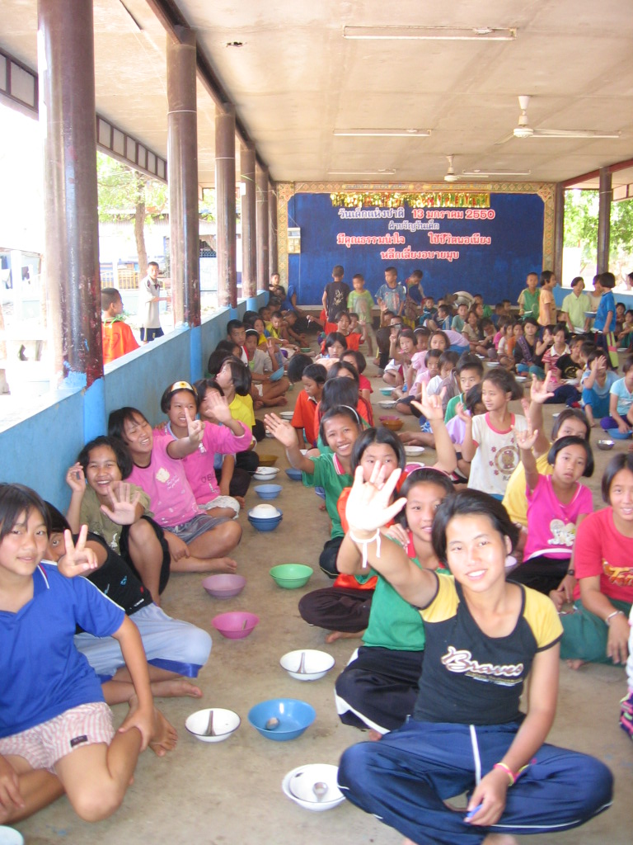
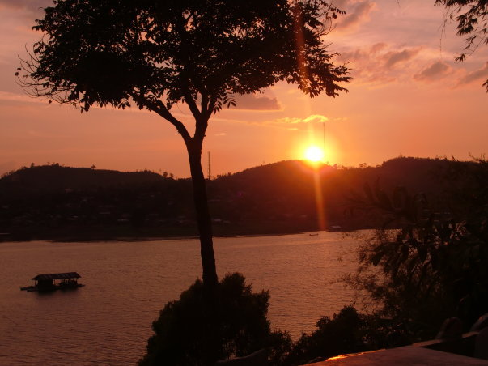
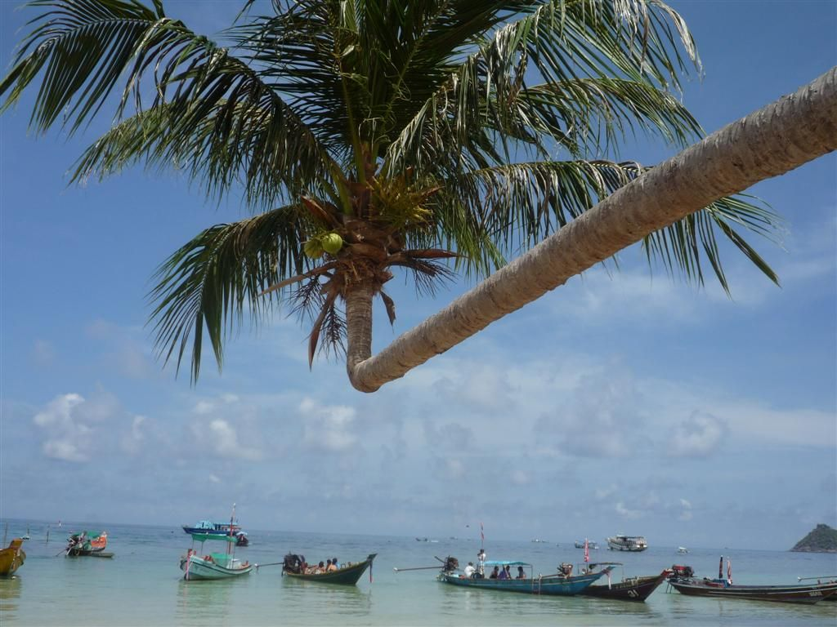
Thailand Experience – 4 weeks $1699
Week 1 Bangkok & Kanchanaburi
Week 2 Elephant riding & volunteering
Week 3 Trekking, white-water rafting & volunteering
Week 4 Ko Pha Ngan
realgap.com.au

Slide 13

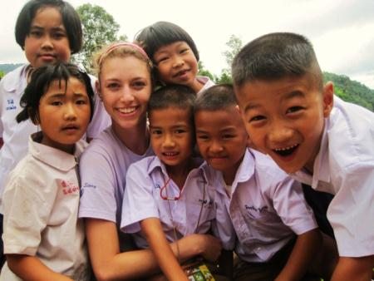
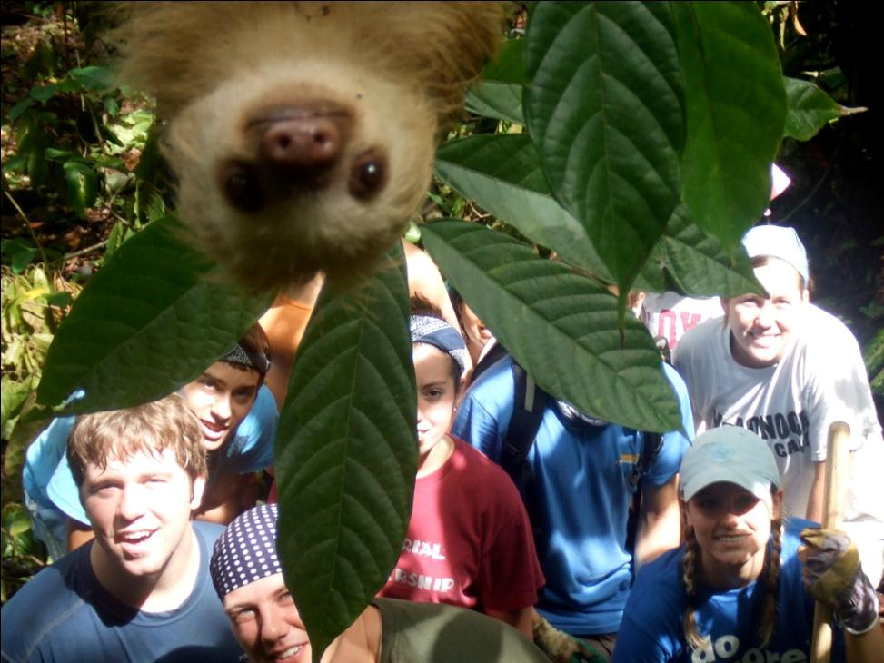
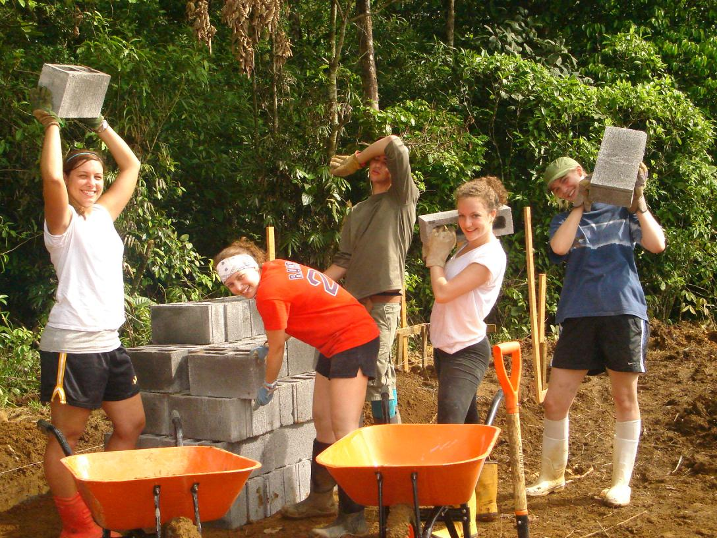

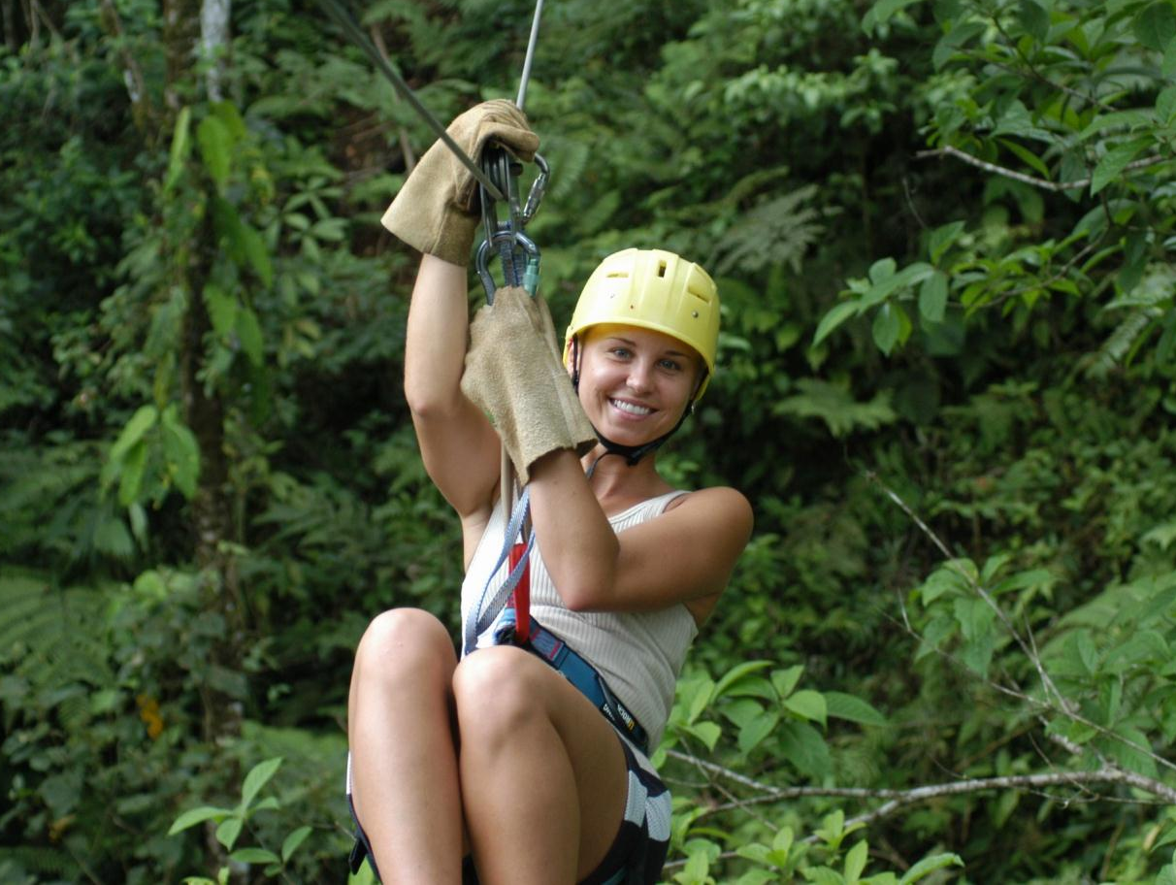
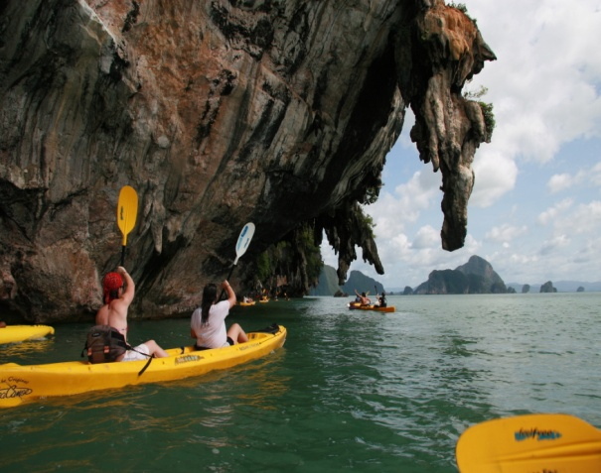
International Student Volunteers
Opportunity to travel and volunteer
Start your adventure today!
· Community development · Environmental management · Wildlife rehabilitation · Sustainable projects
· Hill tribe trek · Zip-lining · Sea Kayaking · Cooking classes · Museums · Temples · Villages · Markets

Slide 14
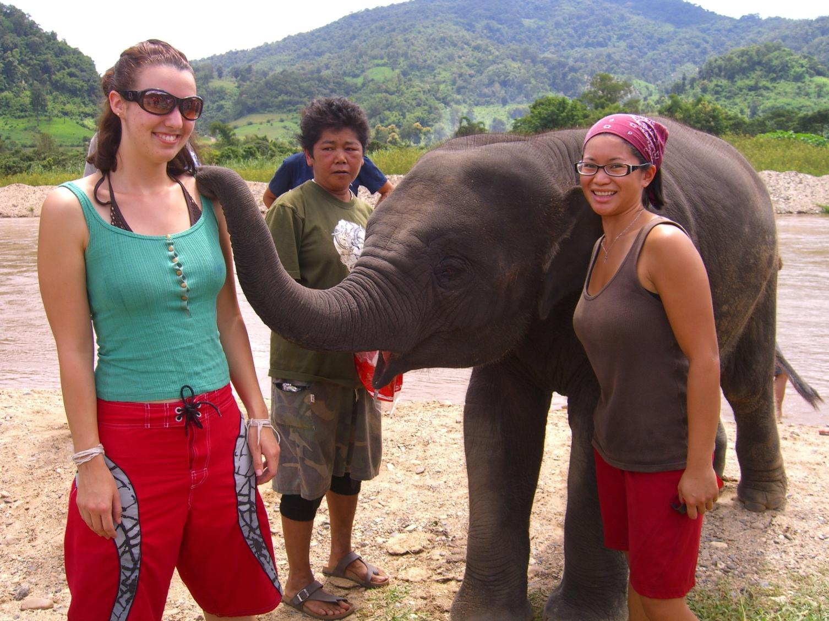
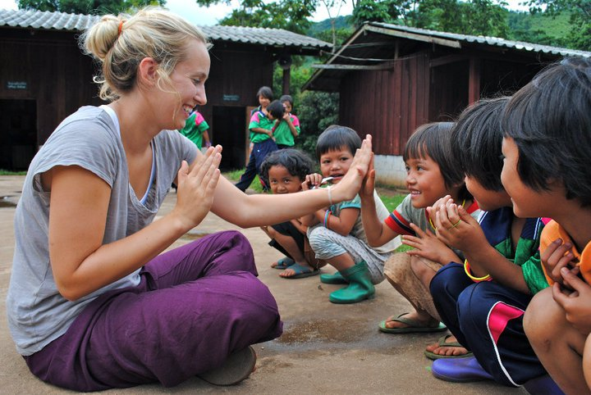
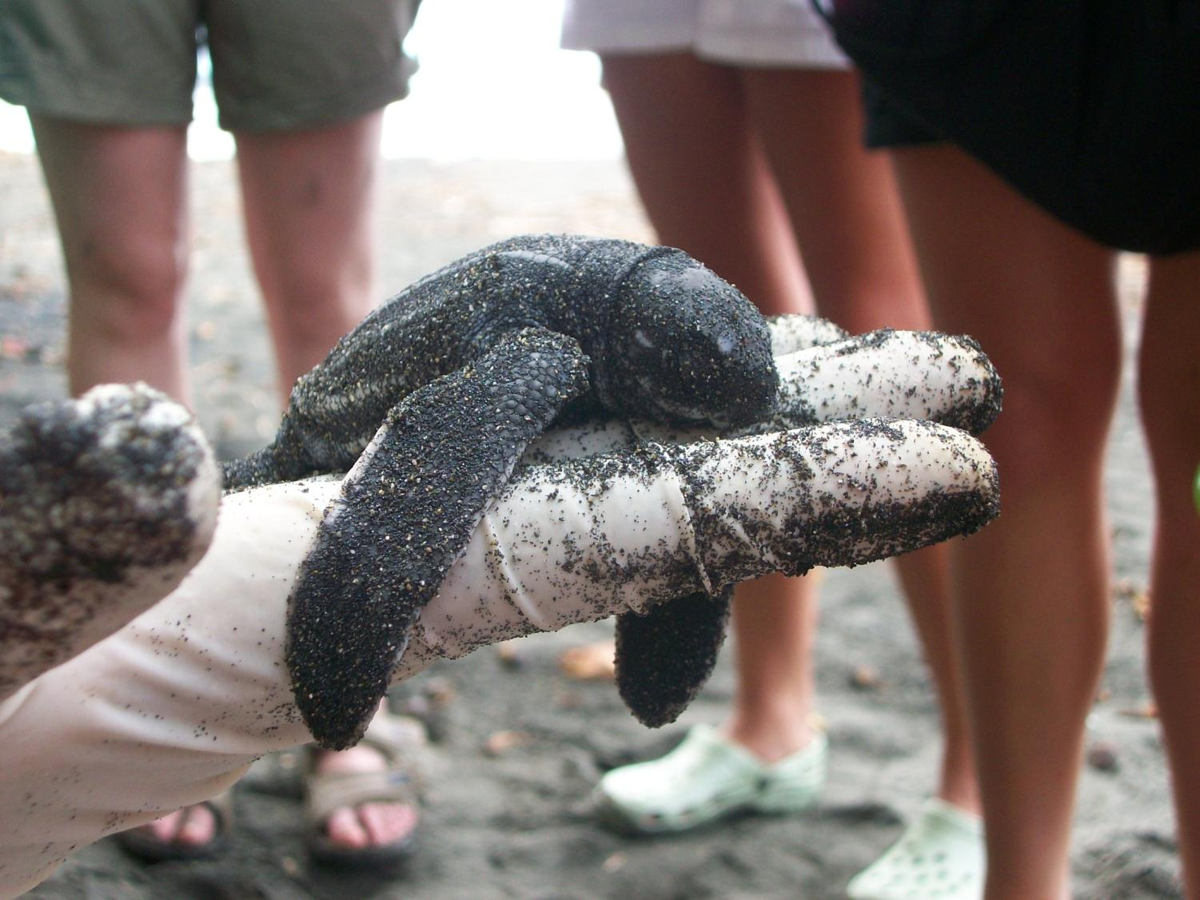
International
Student Volunteers
High School Program
18 Days: 10 days volunteering, 8 days travel and adventure
Departure: January 2014
Ages: 15 – 18yrs
Locations: Costa Rica, Thailand or Vietnam
Cost: Thailand, Vietnam AUD 2,595.00 + airfares *2012 prices
Costa Rica AUD 2,695.00 + airfares *2012 prices
Website: www.isvolunteers.org
Email: au-highschools@isvolunteers.org
Phone: 02 9369 5556

Slide 15
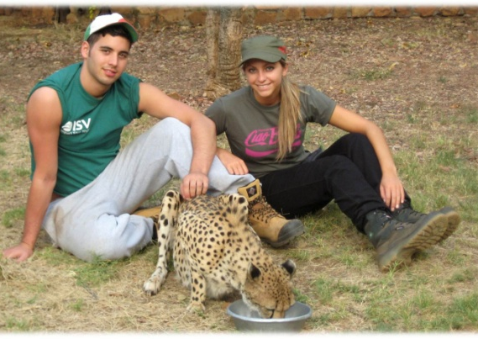
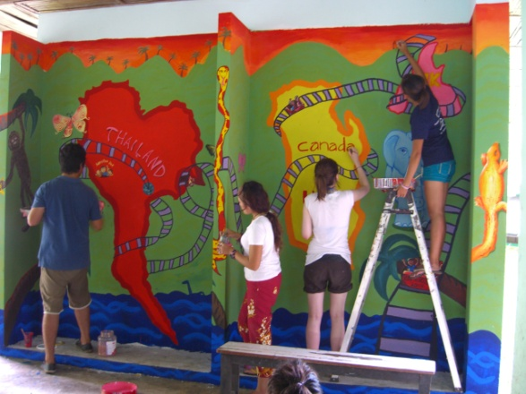
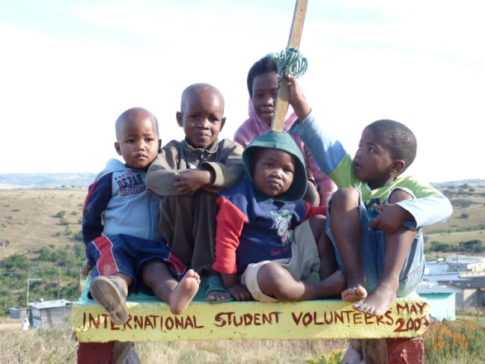
International
Student Volunteers
University Program
4 weeks: 2wks volunteering, 2wks travel and adventure
Departure: Nov 2013- Feb 2014
Ages: 18 years and over
Locations: Costa Rica, Thailand, South Africa
Cost: Costa Rica, South Africa AUD 3,495.00 + airfares *2012 prices Thailand AUD 3,395.00 + airfares *2012 prices
Website: www.isvolunteers.org
Email: au-info@isvolunteers.org
Phone: 02 9369 5556

Slide 16

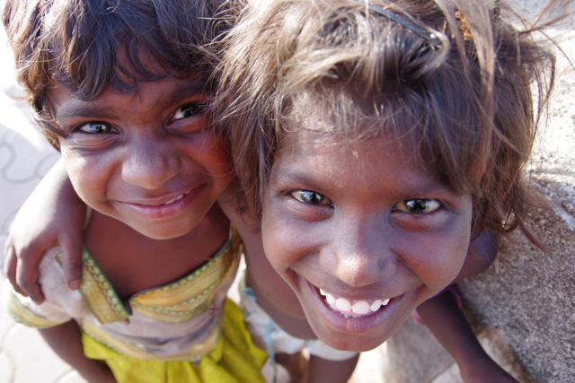
Volunteers In Community Engagement

Slide 17
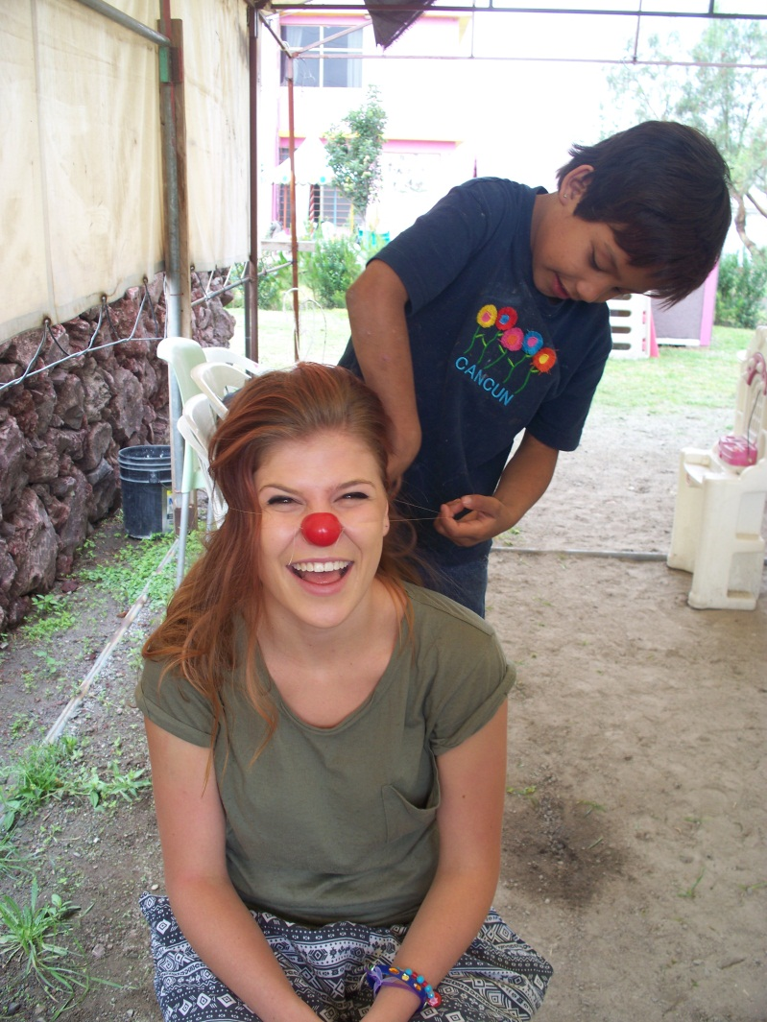
Volunteers In Community Engagement
Who are we?
We are Volunteers In Community Engagement (VOICE) and were formerly Youth Challenge Australia. We are a not for profit, Australian based volunteer sending organisation. We’ve been sending young volunteers on community development programs for over 20 years!
What do we do?
We deliver programs that build the capacity of individuals and the sustainability of communities.
Why volunteer with us?
VOICE is a development organisation which means that all of our programs are identified by the communities we work with, so there is a genuine need for volunteers. By volunteering with VOICE you can be sure that you will make a true impact in these communities.
Where can you volunteer?
India, Vanuatu, Mexico, Costa Rica, Cambodia, Kenya and Indigenous Australia.
In 2012 volunteers built two classrooms for Amalvet School in Vanuatu, taught English classes for San Joaquin community in Mexico and supported a endangered turtle conservation project in Playa Caletas in Costa Rica!
Who can volunteer with us?
Anybody 18+! We send groups 18-25 and 25+.
How long do projects run?
Between 5-10 weeks (July-July, December – February)
What’s the cost?
Between $3900-$4500
For more information …
Call 02 9514 5512
www.voiceaustralia.org.au

Slide 18


Slide 19


Slide 20
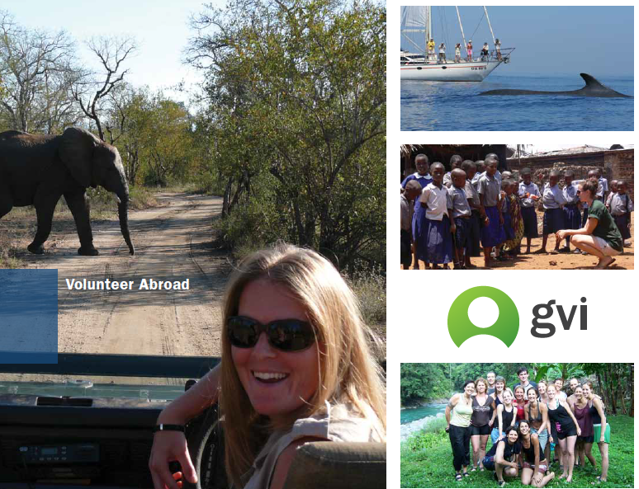

Slide 21
Full List of Organisations
www.antipodeans.com.au
www.projects-abroad.com.au
worldyouth.org.au
www.realgap.com.au
www.i-to-i.com
www.isvolunteers.org
www.voiceaustralia.org.au
http://www.projectfutures.com/events/cycles/2013/
http://www.catholicmission.org.au/educationformation/gig
www.volunteerabroad.com.au
www.australianvolunteers.com
www.gviaustralia.com.au
http://www.volunteering.com.au/become_a_volunteer/volunteer_overseas.asp
www.palms.org.au
http://www.projectfutures.com/events/cycles/

